Slide 1
Biological Risk Assessment, Preparedness, and Response
Crystal Boddie, MPH
Senior Associate, UPMC Center for Health Security

Slide 2
Background on the
UPMC Center for Health Security
History, Mission, Examples of work

Slide 3
Background: UPMC Center for Health Security
Founded by DA Henderson in 1998.
  Dr. Henderson led the World Health Organization’s global smallpox eradication campaign from 1966-1977.
  Concerned that the threat of bioterrorism was not familiar to public health and infectious disease communities, and that medical, scientific, and public health expertise was missing in planning.
  Initially at Johns Hopkins University, then moved to UPMC in 2003
Works to protect people from epidemics and disasters and to ensure resilient communities
Is a mission-driven, non-profit organization known for independent research and policy contributions to public health preparedness, response, and recovery issues

Slide 4
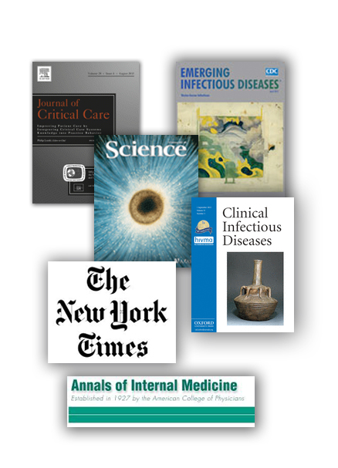
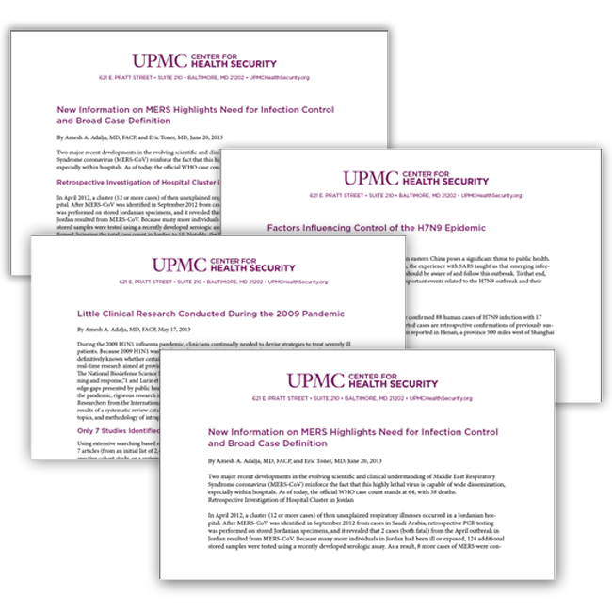
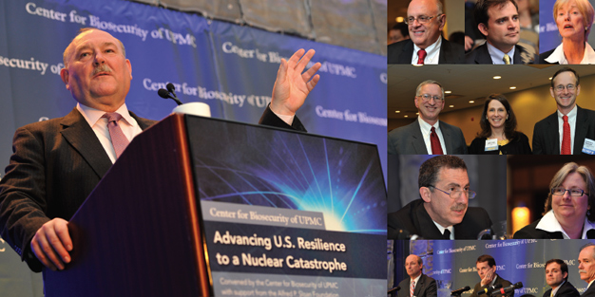
How the Center Conducts its Work
Research and analysis on key health security issues
Provide strategic recommendations during health crises
Convene working groups and conferences to stimulate new thinking
Communicate regularly with policy making community

Slide 5
Major Areas of Domestic Work
Biosurveillance
Informal White House resource
  Convened groups to provide input to White House on series of issues: e.g., disease surveillance, US readiness for MERS, major new public health threats that deserve national attention, AMR, global health security
Biosecurity & biosafety
  Evaluate national security and public health implications of new technologies
  Laboratory safety
Emergency health communications
  Advising on how best to design risk communications during emergencies
Hospital disaster preparedness
  Hospital preparedness for pandemics and mass casualties
  Planning on how best to manage scarce resources in a crisis

Slide 6
Examples of International Work
Assessed Taiwan’s public health preparedness programs for MoH
Multilateral biosecurity dialogue involving US, Singapore, Malaysia, Indonesia
New US-India biosecurity dialogue starting in 2016
Provided invited comments to Kuwait on its national MERS preparedness plans
Convened gathering of health officials from US and China for international dialogue on epidemic preparedness
Hosted Kingdom of Saudi Arabia Deputy Minister of Health to discuss MERS outbreak with US public health community
For the UK Home Office and the US DoD and Department of Homeland Security, prepared an assessment of the security implications of new advances in biology
Worked with Swedish Civil Contingencies Agency and hosted expert session on integrated risk assessment methodologies

Slide 7
Support for Global Health Security
We support ongoing implementation of the BWC, the WHO IHRs, and the aims of the Global Health Security Agenda (GHSA) through:
  Health Care System Strengthening
    Diagnostic capacity
    Treatment capacity
  Public Health System Strengthening
    Biosurveillance
    Epidemiologic response capacity
  Improvements in Biosecurity and Biosafety
  Increased International Scientific Exchange
    To understand and address biological threats (natural and intentional)

Slide 8
Biological Risk Assessment
Biological Weapons Use and Emerging Infectious Diseases

Slide 9
In the Context of the BWC
Risks from misuse of biological agents as weapons are present
The BWC is important for minimizing those risks
  Non-proliferation
  Norms-setting
  International guidelines and standards
Prevention is what we strive for
  It cannot be assured 100%
Preparedness and Response are also critical should prevention fail
  Strides made in prep and resp also help with natural events

Slide 10
Prevention Is Difficult
In nuclear non-proliferation, locking down loose nuclear material is a primary approach to prevention
Biological agents are not as possible to lock down
  Biological agents exist in nature all over the world
  Agents of concern exist in laboratories everywhere
  Industrial uses of biology are ubiquitous
Other approaches to risk reduction are just as important
  Preparedness and response
  Bio-scientist engagement
  International standards and guidelines for biosafety and security

Slide 11
Biological Agents Everywhere
As part of its Select Agent Program, the US Government regulates 80+ pathogens, imposing strict controls on access by U.S. researchers and laboratories.
At the same time, almost all of these pathogens are found in nature and cause disease outbreaks with some regularity.
To demonstrate that, we mapped outbreaks of disease caused by select agent pathogens worldwide in the 22-month period between January 1, 2009, and October 31, 2010

Slide 12
Biological Agents Everywhere
Natural Disease Outbreaks Caused by Select Agent Pathogens. January 1, 2009-October 31, 2010
http://www.upmchealthsecurity.org/our-work/publications/2011/everywhere-you-look-select-agent-pathogens
Notes:
30 diseases
Any reports of outbreaks

Slide 13
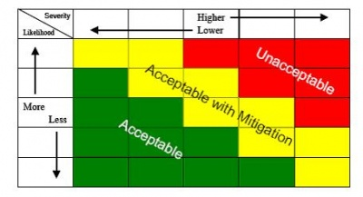
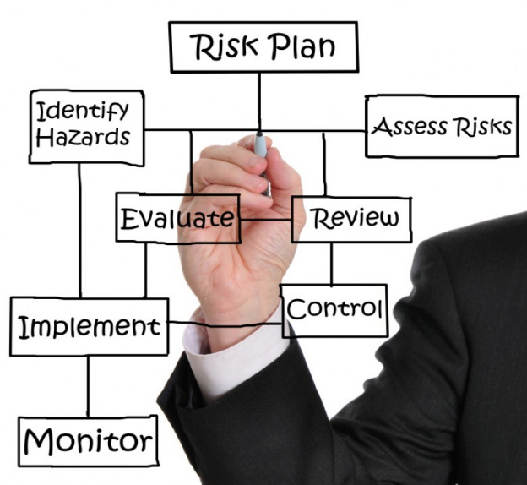
Importance of Risk Assessment
Risk assessment is necessary
  To help us better understand the likelihood and consequences of threats we face
  To aid in prioritizing limited resources
  To help in planning for response
Risk assessment can be accomplished in different ways
  Probabilistic methodology
  Expert judgment-based
  Mixed method

Slide 14
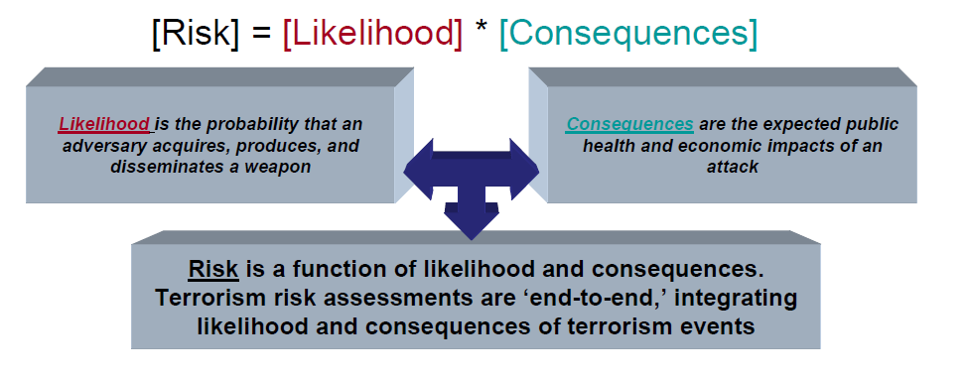
Quantitative Risk Assessment Methodology
Risk is a function of Probability/Likelihood of event occurrence (Threat x Vulnerability) and Consequences of an event (represented by illnesses, fatalities, and economic consequences)
Notes:
One approach, fully quantitative

Slide 15
Semi-Quantitative Approach to Assessing the Bioweapons Threat
In assessing the threat posed by biological weapons use we often rely on expert opinion
  There are few historical examples
We were interested in assessing how US experts define the threat
  We conducted a modified Delphi study
  And found that there is large disagreement among US experts about the threat

Slide 16
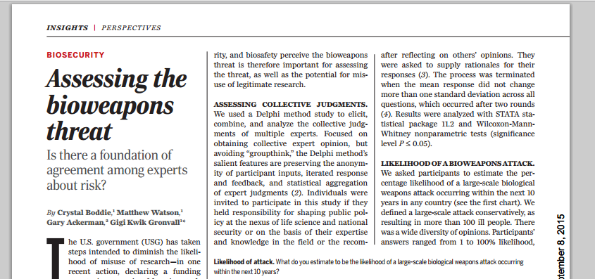

Slide 17
About the Study
Modified Delphi Study
  59 experts at the nexus of biology and security
    In biological science, biodefense, biosecurity, biosafety, national security, public health, veterinary medicine, nonproliferation, defense, counterterrorism, international security policy
  2 Rounds of a Delphi Survey
    Focused on obtaining collective expert opinion, but avoiding “groupthink,”
    Preserves the anonymity of participant inputs
    Iterated response and feedback
    Statistical aggregation of expert judgments

Slide 18
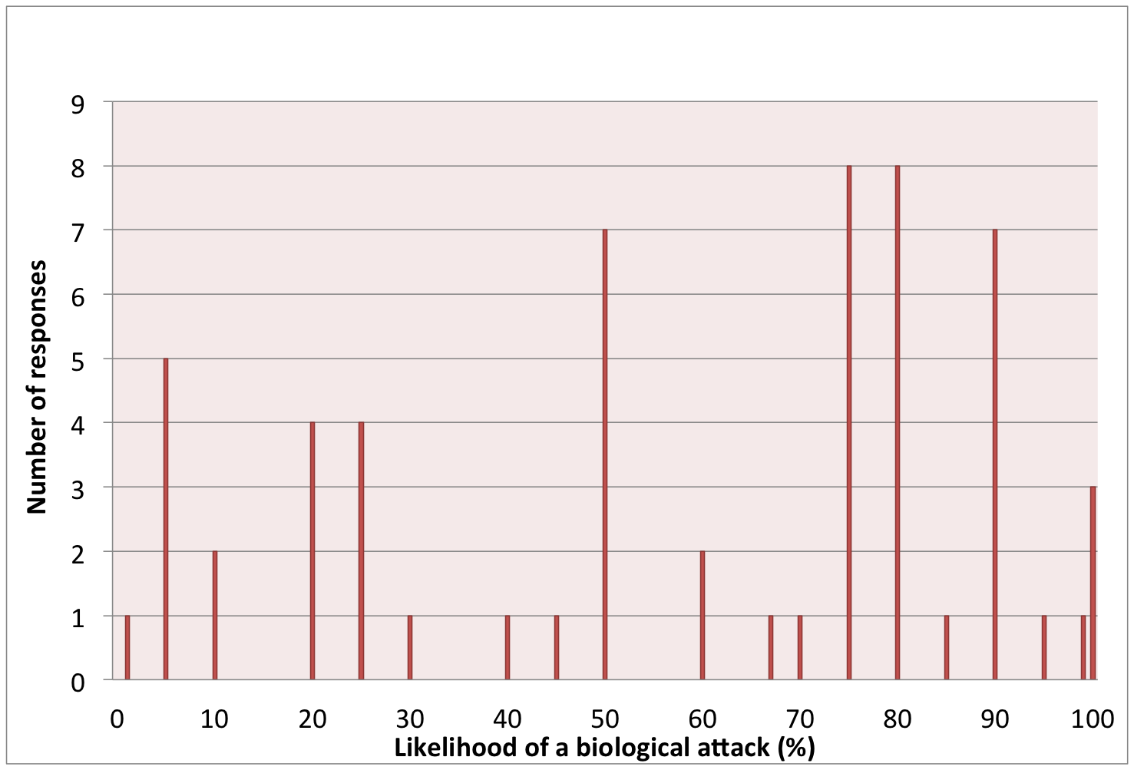
Likelihood of a large-scale biological weapons attack to occur within the next 10 years

Slide 19
Most and Least Likely Actors
Wide range of opinions, with some significant findings:
  State bioweapons use thought to be significantly less likely than non-state or terrorist use (p<0.001)
    Particularly overt use by a state actor
  According to our study religious extremists, politically motivated (right and left wing) individuals and organizations, and disgruntled individuals were considered to be potential perpetrators of future biological attacks

Slide 20
Likelihood that a biological agent will be used as a weapon in the next 10 years

Slide 21
Health Care and Public Health Preparedness
Preparing to respond to a biological crisis

Slide 22
Preparedness for Public Health Emergencies in the US
Efforts at the national, state, and local levels to prepare to protect the health of the public following epidemics, natural disasters, and terrorism
Federal (national) government roles
  Provide scientific guidance, funding, technical assistance during health emergencies
  Two major funding streams: CDC for public health agencies; HHS Asst Sec for Preparedness and Response (ASPR) for hospitals
State and local roles:
  On the ground preparations and response: epidemiology, surveillance, risk assessment, public communication, emergency vaccination programs, hospital care, etc.

Slide 23
National Level Public Health Preparedness
Informed by risk assessment, the Federal government has the responsibility for stockpiling medical countermeasures (MCMs)
  Vaccines, drugs, diagnostics, and sometimes medical devices such as ventilators
  The national government invests strategically in advancing development of MCMs
    Often there is no commercial market
    The government is a guaranteed buyer, and provides funding through advanced development
    MCMs are then stockpiled and stored in the event they are needed
Example:
  Ebola vaccines were being worked on by the NIH and Department of Defense
    They were developed for biodefense, but brought through clinical trials during the outbreak in West Africa

Slide 24
State and Local Public Health Preparedness
In the US, state and local public health agencies are tasked with preparing for epidemics and disasters
They take the lead in a number of areas:
  Surveillance for outbreaks and attacks
    Traditional surveillance and disease reporting
    Syndromic surveillance
    Environmental surveillance – BioWatch
  Planning for response – pandemics and bioterrorism
  Response:
    Medical countermeasures dispensing
    Coordination of regional medical care
    Quarantine and contact tracing
    Allocating scarce medical resources such as vaccines or ventillators

Slide 25

Healthcare Preparedness and Response
Hospitals are at the front lines of response to epidemics and disasters
  Astute clinicians are often the first to recognize a biological event
  The healthcare system can become overwhelmed in a large event (either natural or intentional)
In order to better prepare to respond to epidemics and disasters
  Healthcare coalitions have formed
    Public health agency at the center
    Multiple hospitals
    Outpatient facilities
    Emergency management agencies
  Together, these regional coalitions are better able to plan for and handle large events

Slide 26
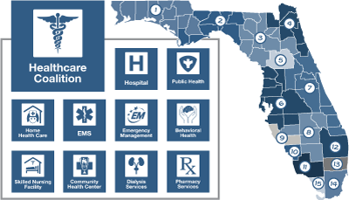
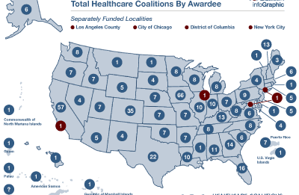
Healthcare Coalitions

Slide 27
Global Preparedness and Response
WHO is currently undergoing reforms in response to Ebola
  Ring fenced funding (earmarked for emergencies)
  Streamlining the organization to improve emergency response capabilities
  Developing a global health emergency response workforce
These reforms, if enacted, will help with both naturally occurring and intentionally caused outbreaks
The Global Health Security Agenda is also working in 50 nations to develop:
  Biosurveillance systems
  Biosecurity and biosafety
  Preparedness and response capabilities
Notes:
Series of foreign medical teams
Saudi and UAE are in.

Slide 28

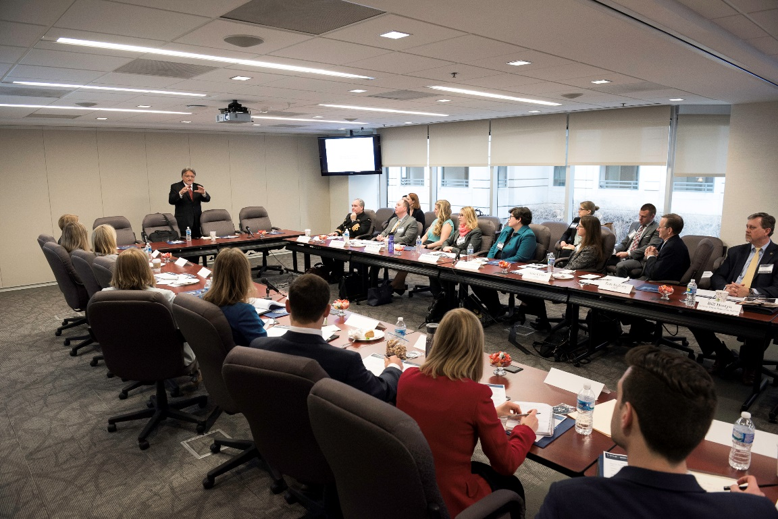
Building the Next Generation of BWC/Biosecurity Experts
Fellows learn about the field of biosecurity broadly, engage with their peers and meet experts and leaders in the field

Slide 29
Thank You!
Contact information:
Crystal R. Boddie, MPH
Senior Associate
UPMC Center for Health Security
boddiecr@upmc.edu
1-443-573-4528
www.upmchealthsecurity.org

